Slide 1

Talent Fusion
Vaishnavi Bhoite

Slide 2
TABLE CONTENTS
Problem Statement & Solution
Product Objectives
Style Guide
Audience
User Segmentation
User needs
Personas
UX research methods you applied for your project
Information Architecture
Error Handling
Card Sorting
Planes
Usability Testing
Use Cases

Slide 3
PROBLEMS
SOLUTIONS
Many individuals struggle with finding career direction and navigating the job market, and traditional career guidance resources are often impersonal and not tailored to individual needs.
Talent Fusion provides personalized mentorship and guidance from experts who have lived similar career journeys, as well as a customized matching system to connect users with mentors who share their background and experience.

Slide 4
Product Objectives
Personalized career guidance
Mentorship
Continuous improvement:
01
03
05
User-friendly platform
Regular Check-Ins PLAN
02
04
Provide personalized mentorship and guidance to users based on their career goals and aspirations.
Personalized mentorship and guidance should be provided to users based on their career goals and aspirations.
The website should be continuously improved based on user feedback, with new features and functionalities added over time to meet the evolving needs of users.
Platform must be user friendly to use and simple to understand its working.
The website should encourage regular check-ins between mentors and users to ensure that they are making progress towards their career goals.

Slide 5

Personalized Guidance And Mentorship
Many individuals may feel lost or unsure about their career path, and may need guidance that is tailored to their specific needs and goals.

Slide 6

Access to expertise And Experience
Users may be seeking advice from individuals who have extensive experience and expertise in their chosen field.

Slide 7
Customized Mentor Matching
Users may also value the ability to connect with mentors who share their background and experience, as this can help build trust and facilitate more effective communication.

Slide 8
Ongoing Feedback And Support
Users may need ongoing feedback and support as they navigate their career path, helping them stay motivated and make progress towards their goals.

Slide 9
Community And
Networking
Many users may value the opportunity to connect with a community of individuals who share similar interests and career goals.

Slide 10
Flexibility And
Convenience
Users may have busy schedules or other commitments that make it difficult to attend traditional in-person mentorship programs. Talent Fusion’s mentorship system is flexible and can be accessed online from anywhere.

Slide 11
Flexibility And
Convenience
Users may have busy schedules or other commitments that make it difficult to attend traditional in-person mentorship programs. Talent Fusion’s mentorship system is flexible and can be accessed online from anywhere.

Slide 12
Style Guide
Primary Colors Secondary Color Notification Color Information Color
#CA6FFF #fe9d67ff #ff0000ff #00ff00ff
#

Slide 13
Style Guide
Typography:
Text:
Poppins 13 Regular
Buttons:
Primary: Poppins 16 Medium
Background Color : Dark Blue #130160
Heading:
Primary: Poppins 16 Semi-bold
Secondary: Poppins 14 Semi-bol

Slide 14

AUDIENCE
Target Fusion is primarily targeted toward individuals who are seeking career guidance and mentorship. The audience for this application is individuals who are struggling to find their career direction and navigate the job market. This could include recent graduates, early-career professionals, and individuals looking to make a career change.
This application is particularly useful for those who feel lost or overwhelmed in their job search, or those who feel that traditional career guidance resources are not meeting their needs.
Overall, the application would appeal to individuals who are seeking personalized and tailored support in their career journey, and who value the insights and experiences of others who have been in similar positions.

Slide 15
USER SEGMENTATION
Recent Graduates
Mid-career professionals
Entrepreneurs
60%
30%
10%
This user group consists of individuals who have recently graduated from college or university and are just starting their careers
This user group consists of individuals who have been working in their chosen field for several years and are looking to take their career to the next level.
This user group consists of individuals who are starting or running their own businesses. They may be looking for guidance on how to develop their business strategy, raise capital, build their team, or scale their operations.

Slide 16






USER
NEEDS
Personalized guidance and mentorship
Customized mentor matching
Community and networking
Access to expertise
Ongoing feedback and support
Flexibility and convenience

Slide 17
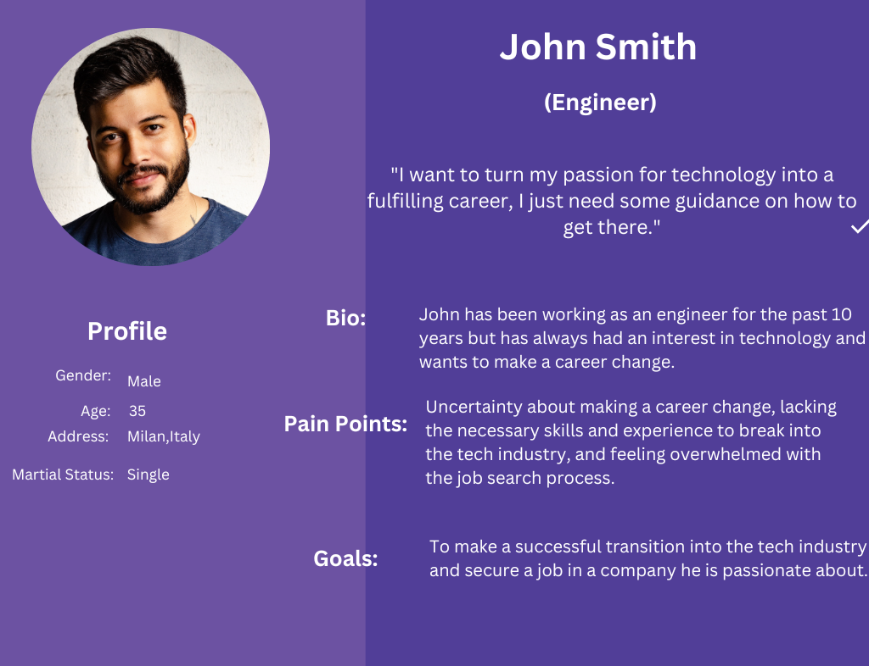
Personas

Slide 18
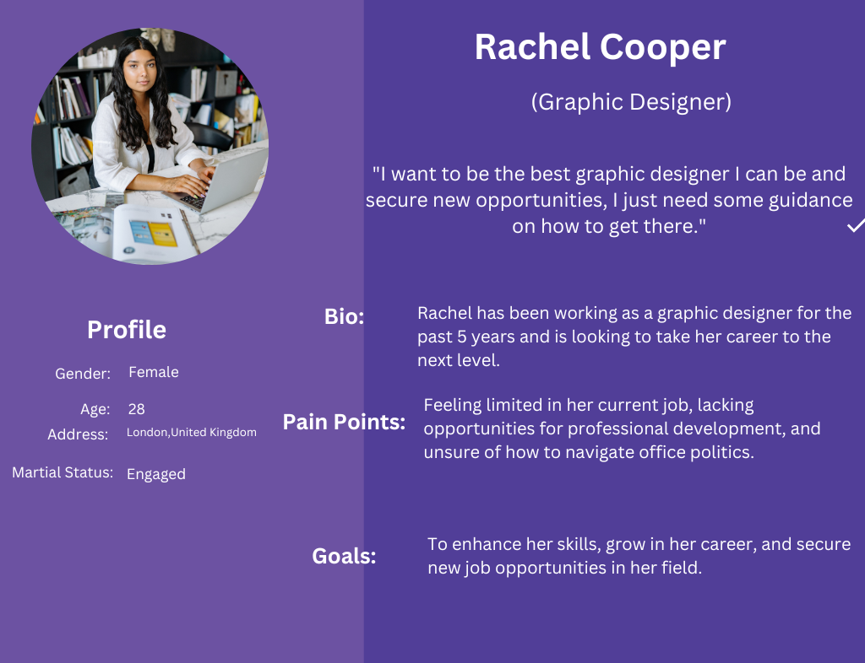
Personas

Slide 19
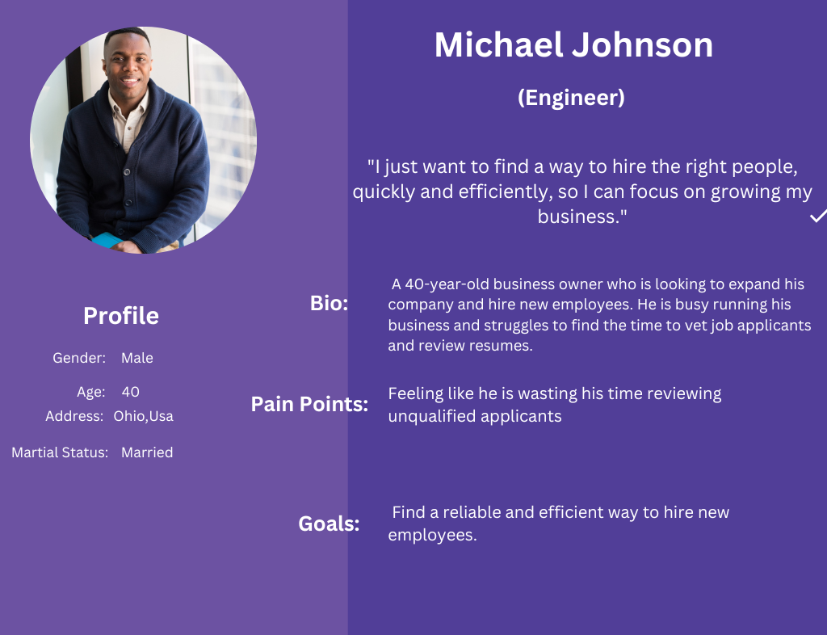
Personas

Slide 20
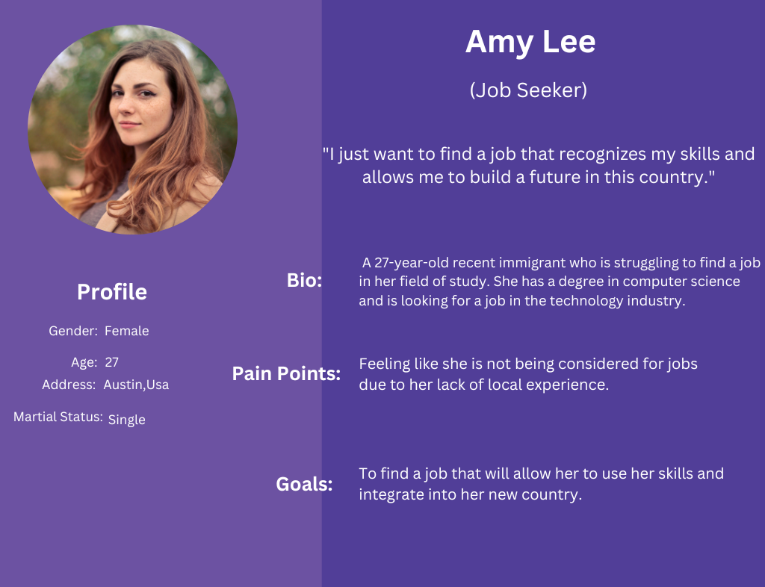
Personas

Slide 21
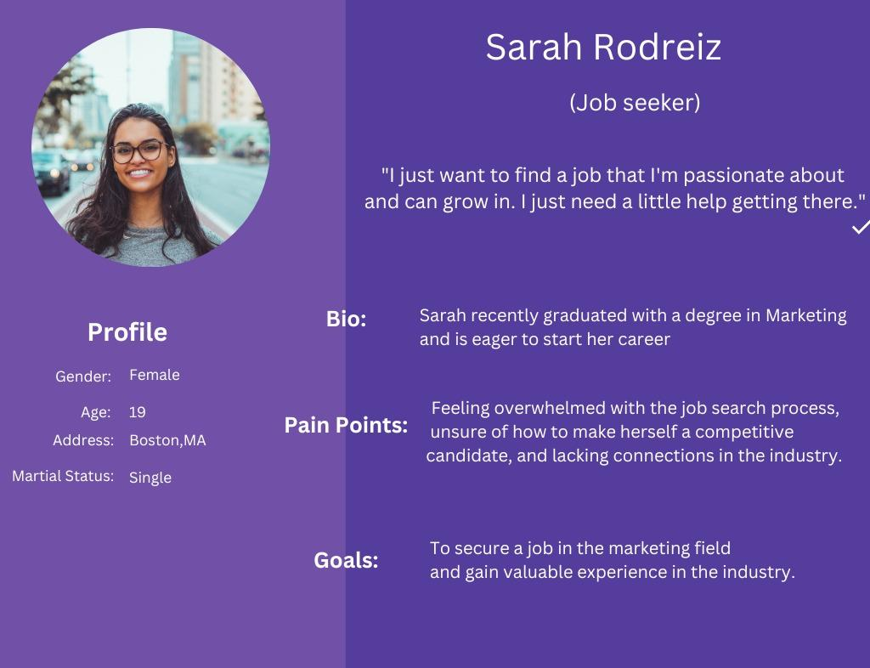
Personas

Slide 22
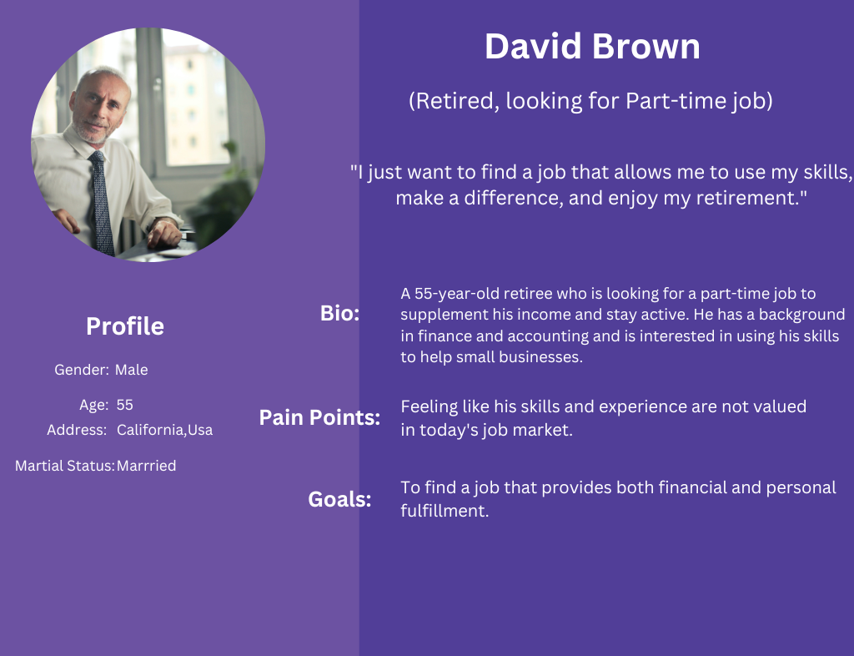
Personas

Slide 23


Research Methods
Concept Testing
User Interview

Slide 24
Research Method - Concept Testing
We performed this to get customer input on our design when it was still in its early phases.
It assisted us in writing out the requirements necessary to continue with the prototype.
It enabled us to learn whether clients were engaged with the concept and would be interested in using the product.
The concept was put into practice, and feedback was recorded.
After speaking with several people, we were able to determine what functions were absolutely necessary.

Slide 25
Research Method - User Interview
Individual conversations with users provided insight into how each user operates. They make it possible for us to learn in-depth details regarding a user's views, experiences, and needs.
Few interviews were conducted online and few were conducted in person.
All the interviews were scheduled one on one with the random target audience of our application.

Slide 26
Questions Asked in User Interview
1. How easy was it to navigate and use the application?
2. Were you able to find a mentor that matched your needs and background?
3. How satisfied were you with the personalized mentorship and guidance you received?
4. Was the mentor responsive and helpful?
5. Did the mentorship help you in making informed career decisions?

Slide 27
Important conclusions from Interview
More detailed information or study guides for the skill set needs to be improved
Core technical mock interview round for better preparation for the interview
Participants expects deals and promotions as well as referral option with some benefit at least for frequent users

Slide 28
Information Architecture
Bottom-Up
Approach
Identifying Personas
Identifying actual need of target audience
Then building the application step by step by performing testing

Slide 29
Error Handling
Sign Up
User must enter their Name, Email as well as Password in order to register successfully, other he/she will not be able to register.
Sign In
The user is required to enter User_ID as well as Password in order login into the application otherwise the application will throw an error message restricting access to the app.

Slide 30
Card Sorting
Closed Card Sorting
Open Card Sorting
Closed card sorting is a version where users are required to arrange the individual cards into these specified categories using a predetermined set of categories. How consumers conceptualize a set is not revealed by closed card sorting.
Participants must group concepts from your website's elements into categories that make sense to them, and they must give each category a name that they believe appropriately defines the topics it contains.

Slide 31
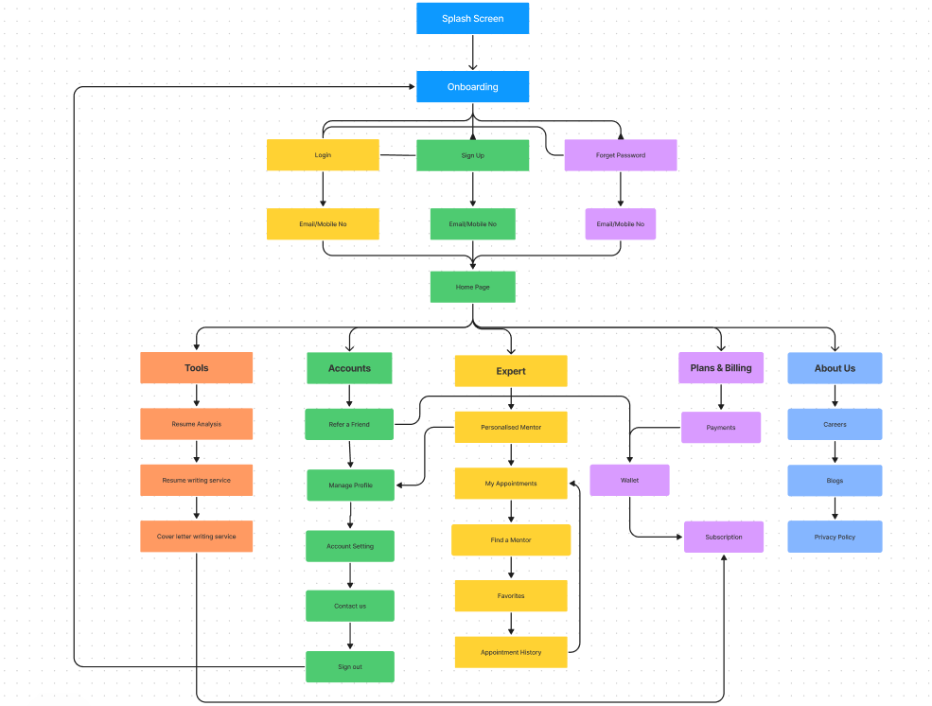
Closed Card Sorting

Slide 32
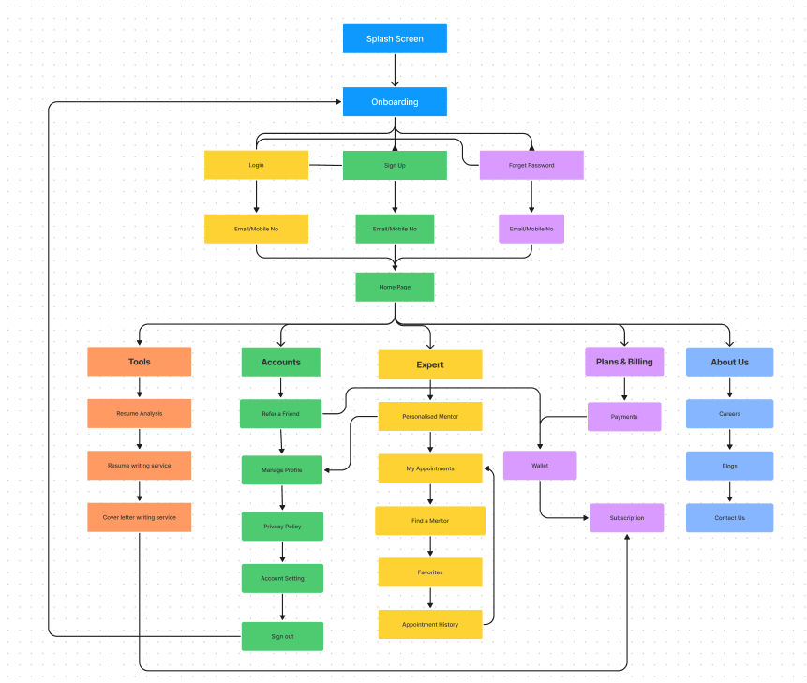
Open Card Sorting

Slide 33



Planes
Strategy Plane
Surface Plane
Designed a series of image-heavy pages. The finished product will provide customers with an immersive experience, such as bringing users to the meeting confirmation page, using this prototype.
Analyzed target audience took into account user demands and the product's goals

Slide 34


Planes
Skeleton Plane
Structure Plane
The conceptual architecture of the website is described by this plane. The evolution of the interface, navigation, and information design is evident when using this plane.
The structure plane aids in defining the nature of the finished product. This plane contributes in the establishment of the site's structure.

Slide 35
Usability Testing
Usability testing is a method of evaluating the effectiveness, efficiency, and satisfaction of a product or system, such as a website, software application, or physical device, by testing it with representative users.
The primary objective of usability testing is to identify any usability issues or problems that users may encounter when interacting with the product or system, and to gather feedback that can be used to improve the design.

Slide 36
Usability Testing Objective
Identify usability problems: Usability testing helps identify any difficulties users may have in interacting with a product, such as confusion over the purpose of a feature or difficulty finding information.
Measure user satisfaction: By gathering feedback from users during testing, usability testing can measure user satisfaction with the product and identify areas where improvements can be made.
Test usability hypotheses: Usability testing can be used to validate or refute hypotheses about the usability of a product or specific features.
Compare against competitors: Usability testing can provide insights into how a product compares to similar products on the market and identify areas where it can be improved to gain a competitive advantage.

Slide 37
Usability Testing Task
Task 1
Creating User Account
Opening the app and completing the steps necessary to establish a new account are the requirements for the completion of this task.
Task 2
Finding Mentor
Opening the app and navigating through the workflow to find the personalized mentor who shares a similar background
Task 3
Finding Suitable Jobs
Opening the app and navigating through the workflow to find the jobs recommended based on the profile and area of interest

Slide 38
Use Cases
Basic Flow Use Cases
Use Case 1:
Career Changer
Actor
Employee (Jane, a marketing manager who wants to transition into a career in sustainability.)
Basic Flow
Jane visits Fixxer's website and creates an account. She searches for an expert in the sustainability field. Jane schedules a video consultation with an expert in the field. During the consultation, the expert helps Jane identify transferable skills and provides guidance on how to make the transition. The expert also provides resources and connections to help Jane find job opportunities in the sustainability field. Jane uses the guidance and connections from the consultation to successfully transition into a new career in sustainability.

Slide 39
Basic Flow Use Cases
Use Case 2:
Recent Graduate
Actor
Student (John, a recent college graduate who wants to start a career in tech.)
Basic Flow
John creates an account on Fixxer's website and searches for an expert in the tech industry. He schedules a video consultation with an expert in the tech industry.
During the consultation, the expert provides guidance on job search strategies, resume and cover letter writing, and interview techniques. The expert also recommends courses and training to help John build the skills necessary to succeed in the tech industry. John uses the guidance and resources from the consultation to successfully land a job in the tech industry.

Slide 40
Basic Flow Use Cases
Use Case 3:
Professional Seeking Advancement
Actor
Student (Alex, a software developer who wants to move into a management role.)
Basic Flow
Alex creates an account on Fixxer's website and searches for an expert in software development management. He schedules a video consultation with an expert in software development management.
During the consultation, the expert provides guidance on how to build leadership and management skills and how to navigate the hiring process for management roles.
The expert also provides connections to job opportunities in management roles in the software development industry. Alex uses the guidance and connections from the consultation to successfully transition into a management role.

Slide 41
Middle weight Use cases
Use Case 1 - Career Changer Seeking Mentorship
Actor - Employee
Sarah is a marketing professional who is unhappy with her current job and wants to transition to a career in software engineering. She visits the Fixxer platform to find an expert in software engineering who can provide her with personalized guidance and mentorship.
Alternative Flow 1 - Sarah is not able to find an expert in software engineering who meets her requirements. She expands her search to related fields such as computer science or web development.
Alternative Flow 2 - Sarah schedules a video consultation with an expert in software engineering, but due to technical difficulties, the consultation is rescheduled for a later time.
Alternative Flow 3 -The expert Sarah scheduled a consultation with is unavailable. Fixxer automatically suggests a list of alternate experts who can provide similar guidance.

Slide 42
Middle weight Use cases
Use Case 2 - Recent Graduate Seeking Job Opportunities
Actor - Student
John is a recent college graduate who is struggling to find a job in his field of study, which is environmental science. He visits the Fixxer platform to get advice from experts on how to stand out in his job search and get noticed by employers in his field.
Alternative Flow 1- John schedules a consultation with an expert, but due to technical difficulties, the consultation is rescheduled for a later time.
Alternative Flow 2 - The expert John scheduled a consultation with is unavailable. Fixxer automatically suggests a list of alternate experts who can provide similar guidance.
Alternative Flow 3 - John receives conflicting advice from different experts. Fixxer allows him to leave feedback on the quality of the advice he received, which helps the platform to recommend better experts in the future.

Slide 43
Middle weight Use cases
Use Case 3 - Professional Seeking Skill Development
Actor - Employee
Maria is a working professional in the finance industry who wants to develop her skills in data analysis. She visits the Fixxer platform to find an expert in data analysis who can provide her with personalized guidance and support.
Alternative Flow 1 - Maria schedules a consultation with an expert, but due to technical difficulties, the consultation is rescheduled for a later time.
Alternative Flow 2 - The expert Maria scheduled a consultation with is unavailable. Fixxer automatically suggests a list of alternate experts who can provide similar guidance.
Alternative Flow 3 - Maria is not satisfied with the guidance she received. Fixxer allows her to provide feedback on the quality of the advice she received, which helps the platform to recommend better experts in the future.

Slide 44
Middle weight Use cases
Use Case 4 - Job Seeker Looking for Career Guidance
Actor - Employee
Tom is a job seeker who is struggling to find job opportunities in his field of interest, which is graphic design. He visits the Fixxer platform to get advice from experts on how to find job opportunities and build his portfolio.
Alternative Flow 1 - Tom schedules a consultation with an expert, but due to technical difficulties, the consultation is rescheduled for a later time.
Alternative Flow 2 - The expert Tom scheduled a consultation with is unavailable. Fixxer automatically suggests a list of alternate experts who can provide similar guidance.
Alternative Flow 3 - Tom receives conflicting advice from different experts. Fixxer allows him to leave feedback on the quality of the advice he received, which helps the platform to recommend better experts in the future.

Slide 45
Heavy weight Use cases
Use Case 1 - Career Transition
Actor - Working Professional
Use Case Overview
John is a marketing professional who wants to transition into the tech industry. He turns to Fixxer for guidance on how to make this transition successfully.
Subject Area - Career Mentorship Platform
Trigger - John requests a video consultation with a tech industry expert on Fixxer.
Precondition 1 - John has already signed up for a Fixxer account and provided his background and career goals.

Slide 46
Precondition 2 - Fixxer has a pool of experienced mentors and experts in the tech industry.
Alternative Flow A: Landing on a desired job successfully
Description
John has created a Fixxer account, he gets personalized suggestions regarding his carrier. John follows the advice and e up getting the desired job
A1 - The expert reviews John's background and career goals.
A2 - The expert provides John with a personalized career plan and recommends online courses and networking events to help him build the skills and connections he needs to succeed.
A3 - John follows the expert's recommendations and starts to build his network in the tech industry.
Termination outcome
John transitions successfully into a job in the tech industry.

Slide 47
Alternative flow B: The expert recommends joining the internship
Description
John books an appointment with an advisor. The advisor analyses John’s background and suggest to join the internship.
B1 - The expert reviews John's background and career goals.
B2 - The expert advises John that he needs to gain more experience in the tech industry before transitioning into a new job.
B3 - The expert recommends that John look for an internship or part-time job in the tech industry and continue building his skills and network.
Termination outcome
John follows the expert's advice and gains valuable experience in the tech industry.

Slide 48
Alternative flow C: The expert suggests taking courses to gain the necessary skills
Description
The expert suggests John that he needs to improve the skills required to work in a tech industry.
C1 - The expert advises John that his current skills are not a good match for the tech industry.
C2 - The expert recommends that John consider taking courses to gain the necessary skills and experience.
C3 - John follows the expert's advice and takes courses to build his skills.
Termination outcome
John successfully transitions into a job in the tech industry

Slide 49
Heavy weight Use cases
Use Case 2 - Sarah's Job Search
Actor - College Graduate
Use Case Overview
Sarah is a recent college graduate who is looking for her first job. She turns to Fixxer for guidance on how to find the right job for her.
Subject Area - Career Mentorship Platform
Trigger - Sarah requests a video consultation with a job search expert on Fixxer.
Precondition 1 - Sarah has already signed up for a Fixxer account and provided her background and career goals.

Slide 50
Precondition 2 - Fixxer has a pool of experienced career coaches and job search experts.
Alternative Flow A: The expert suggests Sarah with job search strategies
Description
The expert provides Sarah with the required job search strategies as well as websites that are important to look for a job
A1 - The expert reviews Sarah's background and career goals.
A2 - The expert helps Sarah create a strong resume and cover letter.
A3 - The expert provides Sarah with job search strategies and recommends job search websites and networking events.
Termination outcome
Sarah follows the expert's recommendations and lands a job that is a good match for her skills and career goals.

Slide 51
Alternative flow B: The expert advised to continue further education
Description
The advisor suggest Sarah to either continue with the higher studies to gain more knowledge or gain more experience.
B1 - Sarah finds an expert who offers a free 10-minute consultation.
B2 - During the consultation, the expert advises Sarah to gain more work experience or further education in order to increase her chances of finding a job that is a good fit for her.
Termination outcome
Sarah decides to follow the expert's advice and gain more work experience or further education.

Slide 52
Alternative flow C: Sarah is not able to find the advisor
Description
Sarah tries to schedule a meeting with their advisor but unfortunately, she is not able to book an appointment.
C1 - Sarah is unable to find an expert who can provide her with the guidance she needs.
C2 - Sarah contacts Fixxer's customer support, who offer to connect her with an expert who can provide her with the necessary guidance and support.
C3 - Sarah is connected with an expert who provides her with personalized guidance and support to find a job that is a good fit for he
Termination outcome - Sarah finds a job that is a good fit for her with the guidance and support of an expert from Fixxer.

